Slide 1
Quaternions

Slide 2
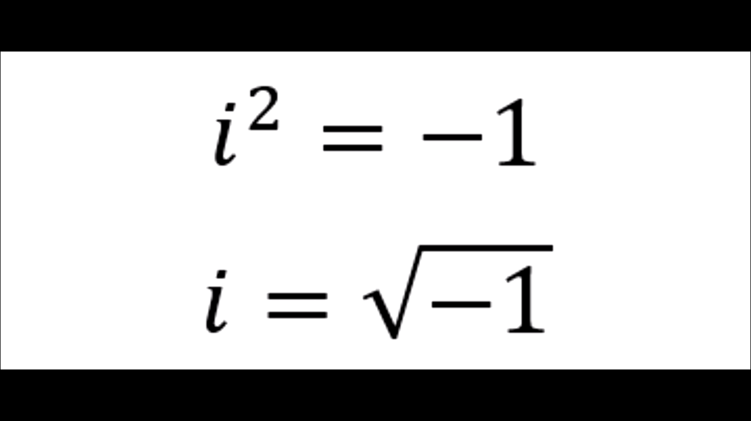

Slide 3
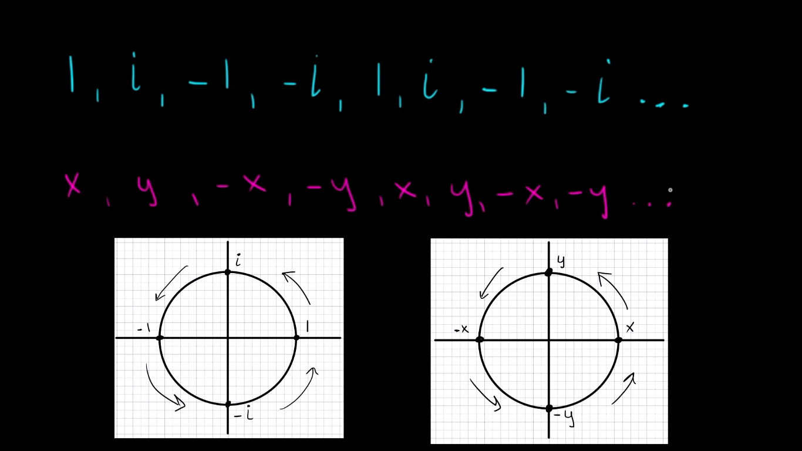
Like we rotate a complex number we can also do the same with a real number on x-y plane and this series results.

Slide 4
We Know what are simple complex numbers and what are there properties.
We can add them multiply them.

Slide 5
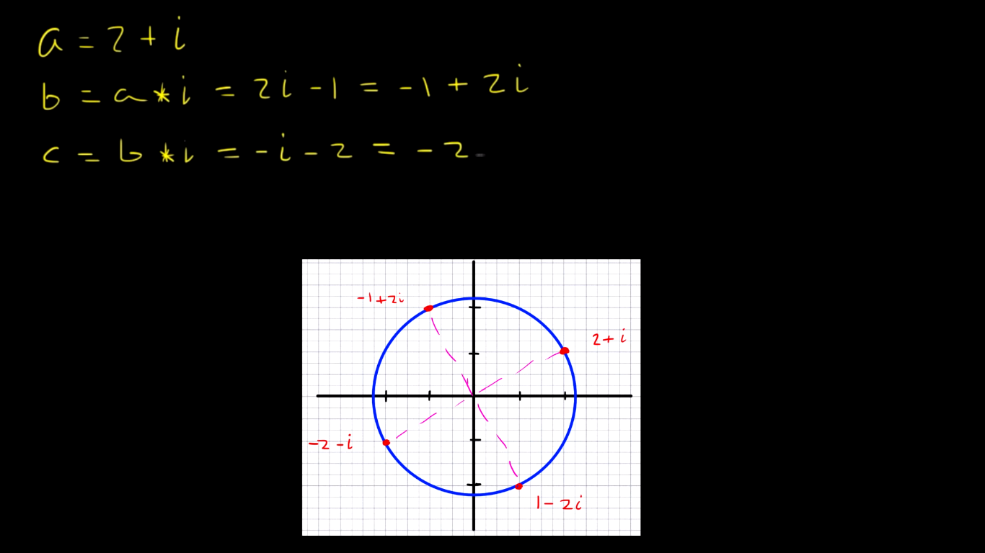
A complex number when multiplied by ‘I’ we
Get a rotated complex number by an angle of
90 degrees on argand plane.

Slide 6
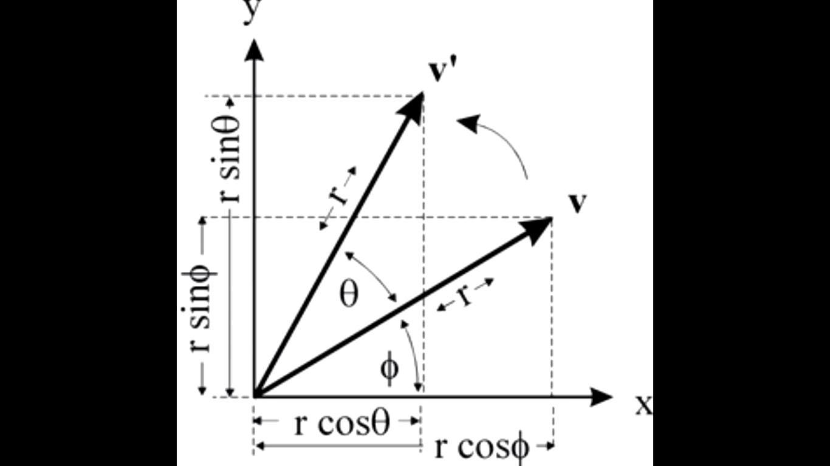
For rotating a
Complex number
by theta we Use
multiplication with
[ e^I*theta ]

Slide 7
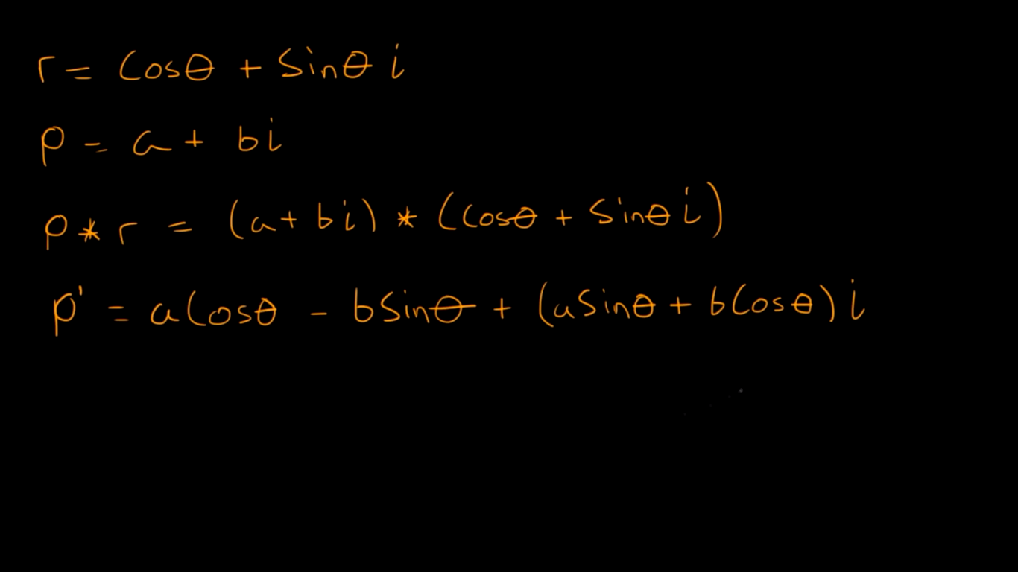

Slide 8
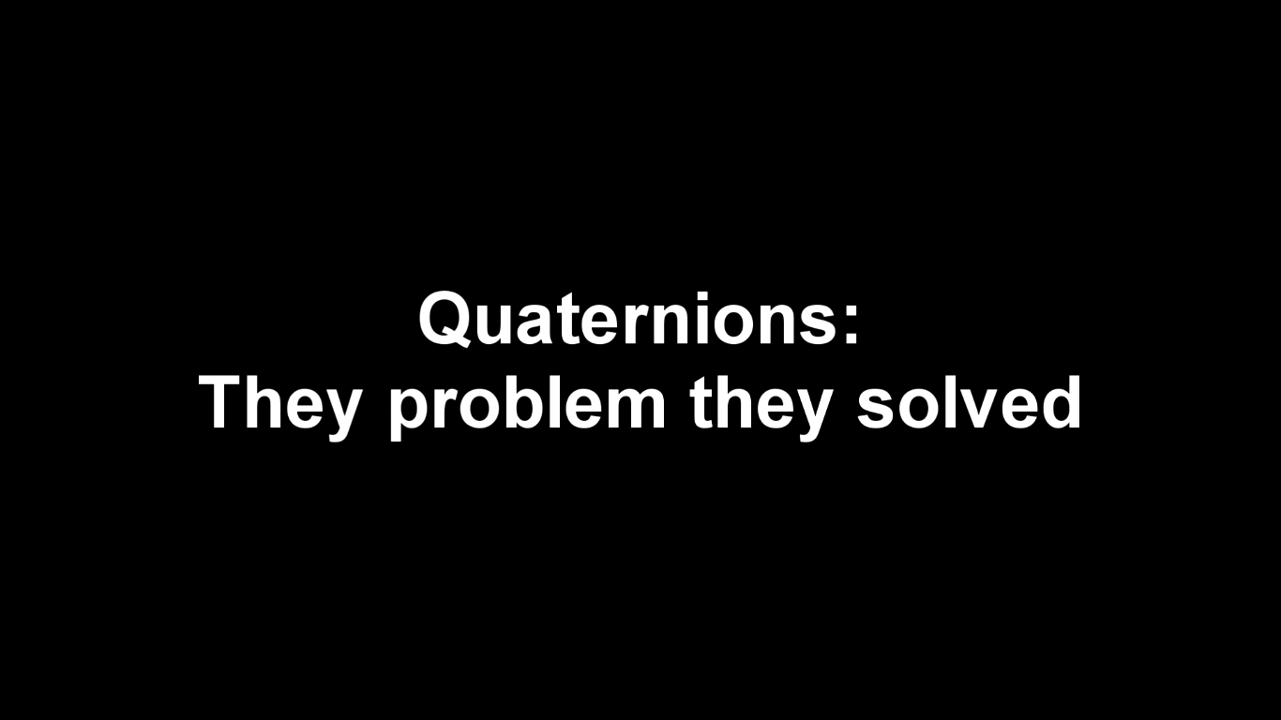

Slide 9
What if we need two complex numbers to work with.
We can assume a j complex axis .
We can add sub but we cannot multiply the numbers.
WHY?
Because we don’t know the multiplication of i*j OR i*j*k.

Slide 10
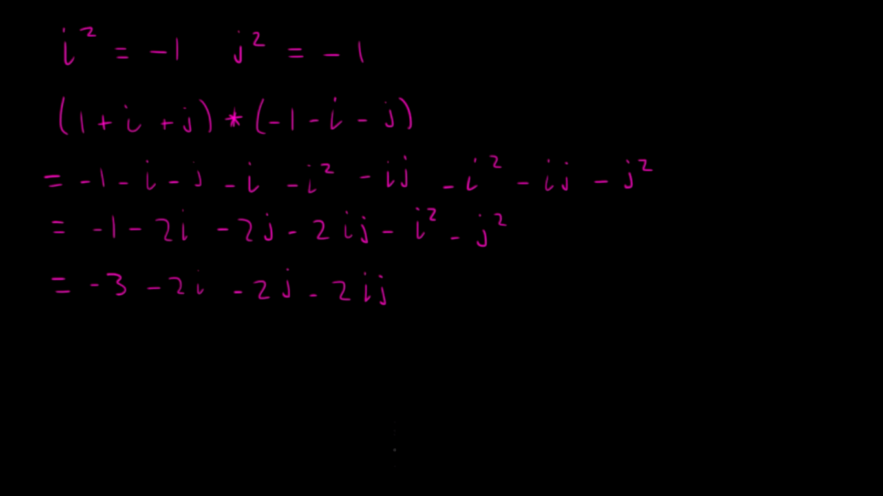

Slide 11
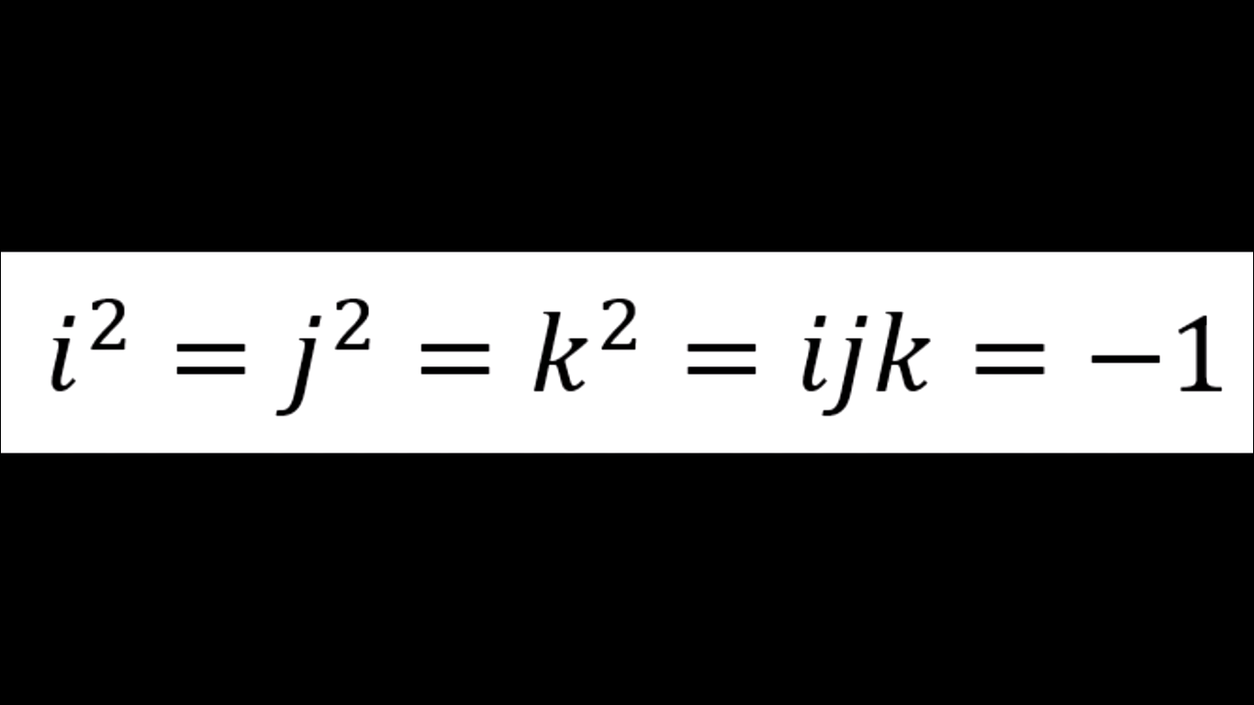
Later this problem was solved and these formulas were developed.
But now due to addition of I,j,k along with real axis we not have 4 dimensions to deal with.

Slide 12
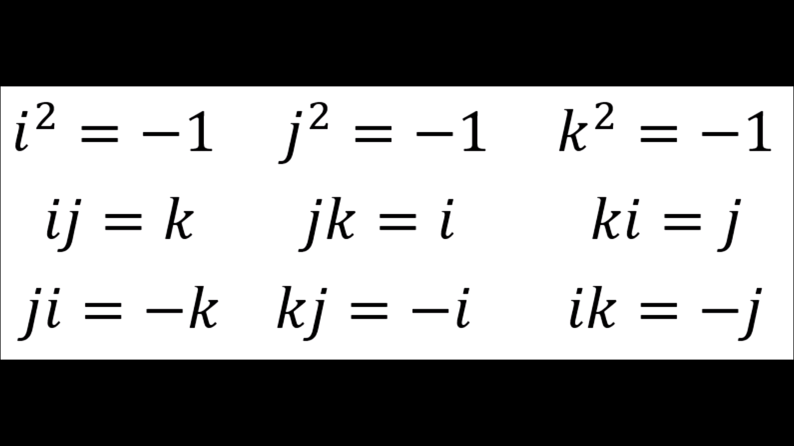
Some additional formulas

Slide 13
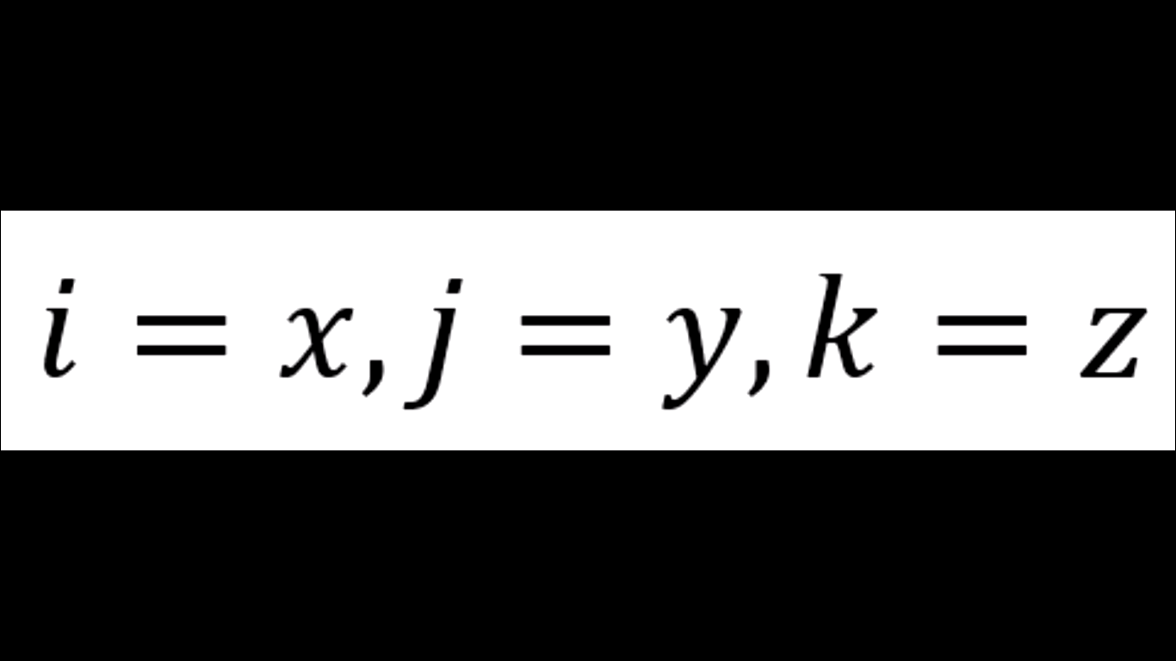
Here we take axis== i,j,k.

Slide 14
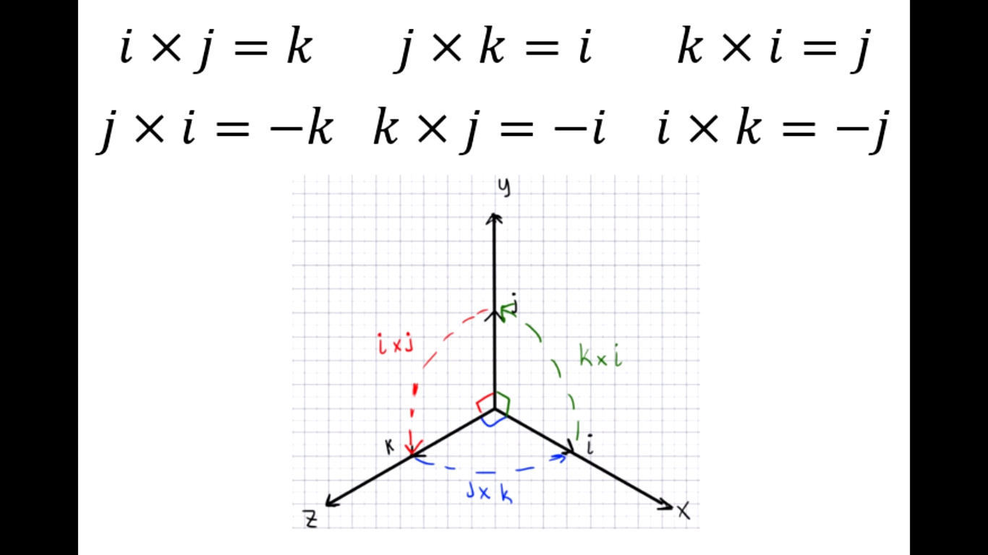
The math we dealt now is equivalent to vector maths.

Slide 15
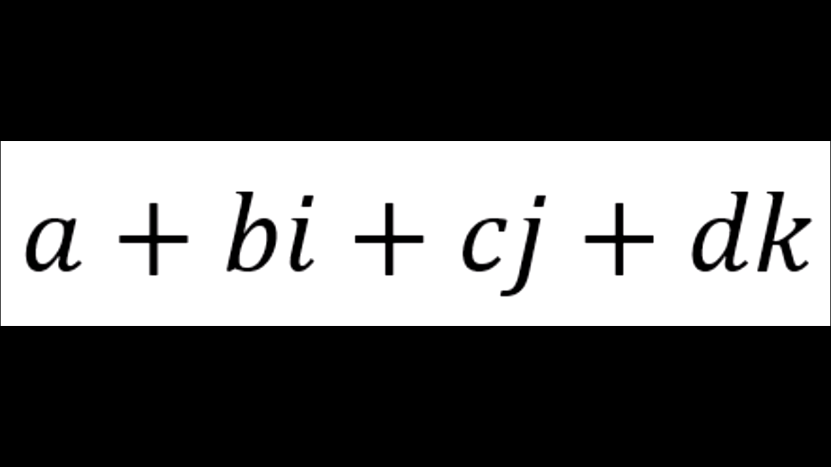
Our quaternion looks like this ! COOL

Slide 16
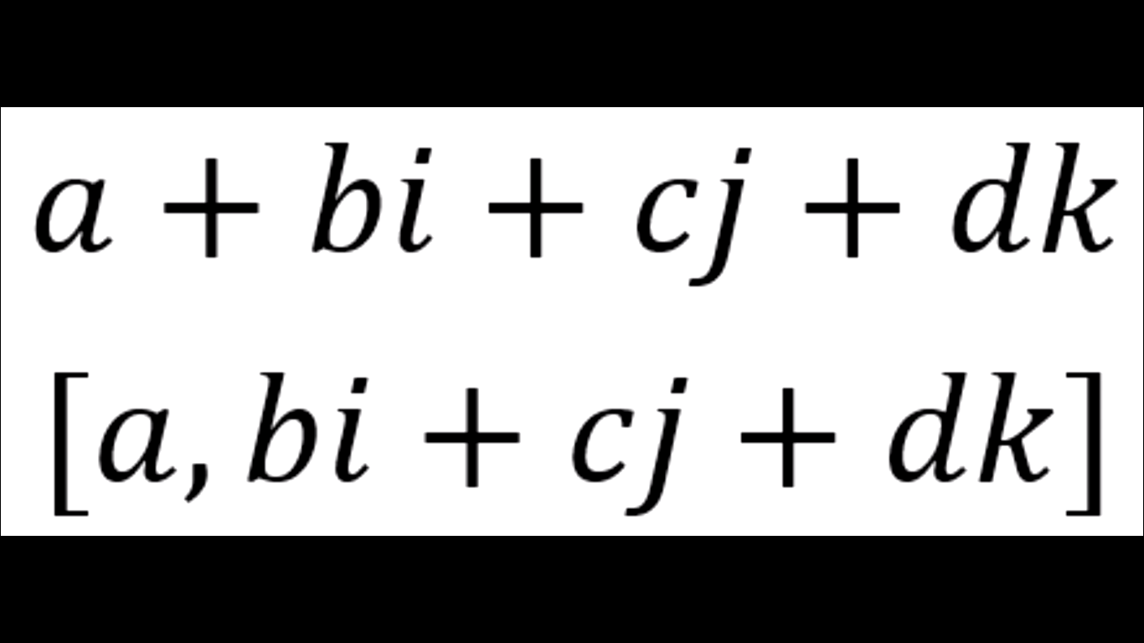
We can also write the real and imaginary part as a ordered pair.

Slide 17
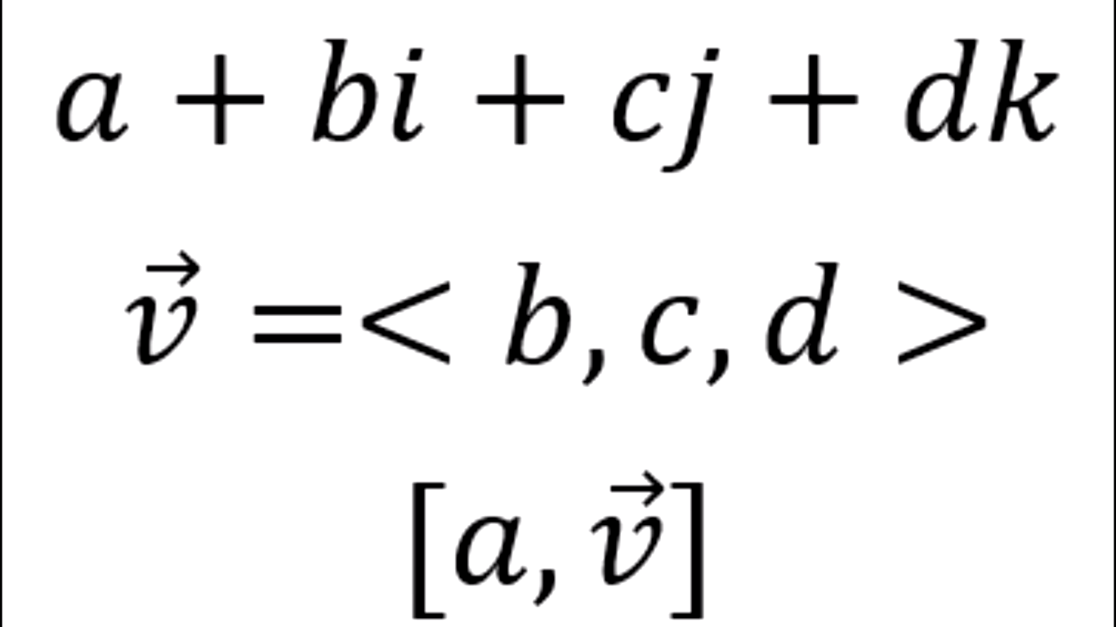
It can also be represented like this manner also with real and vectors parts.

Slide 18
Some math with quaternions

Slide 19
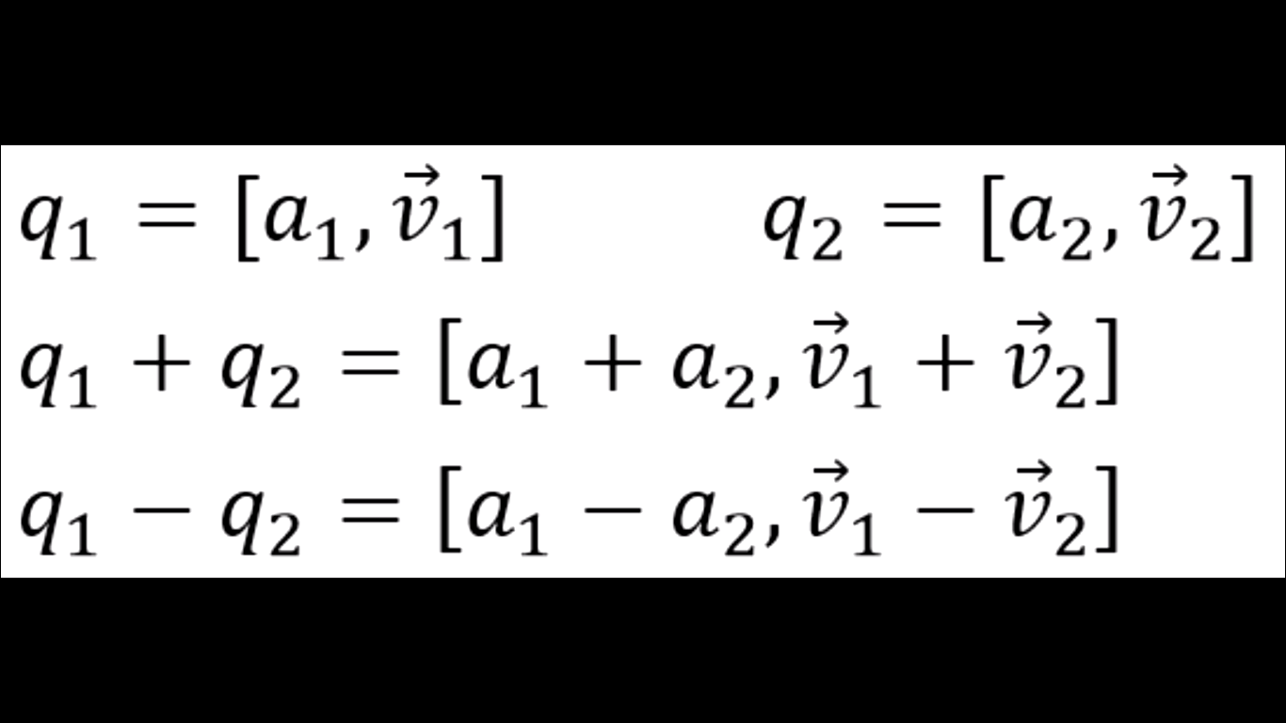
Addition is simple
You need to add real and imaginary parts separately.

Slide 20
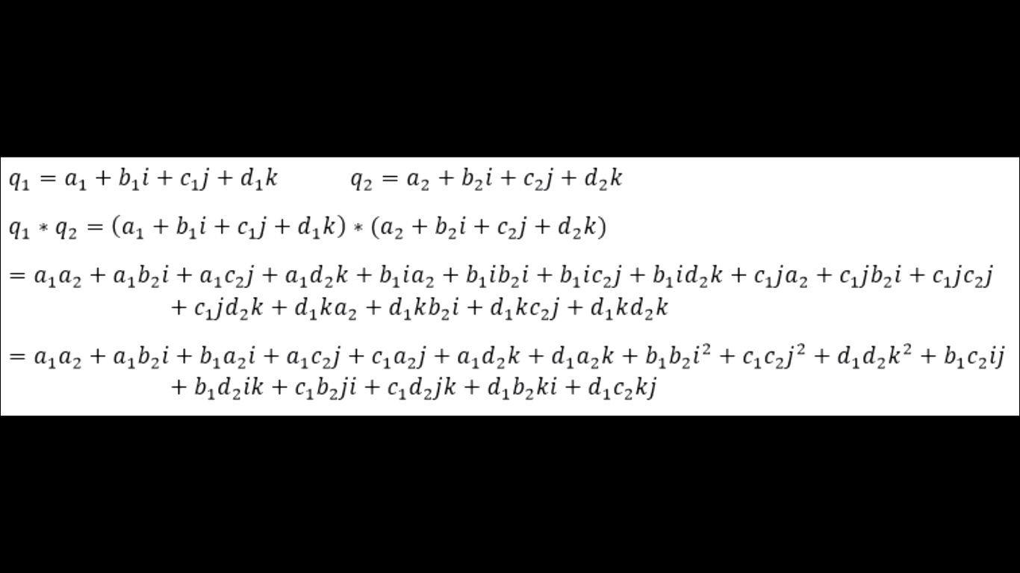
Now comes the multiplication part

Slide 21
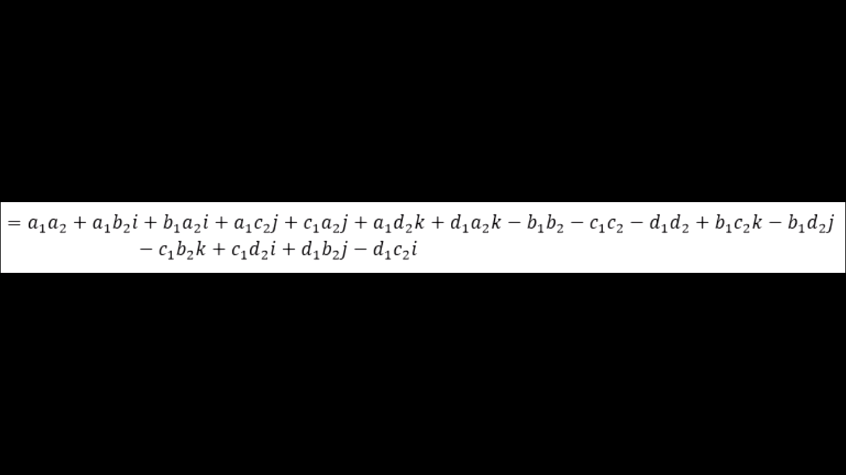
On solving with the rules defined we get this

Slide 22
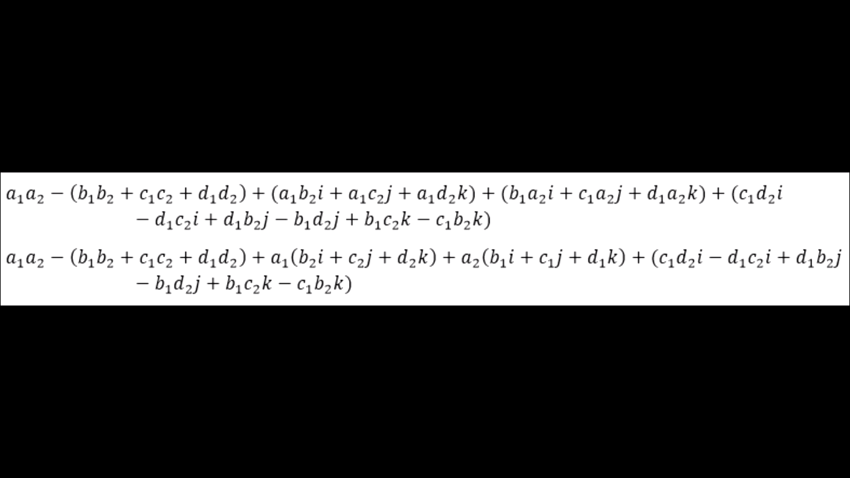
On simplification we get this

Slide 23
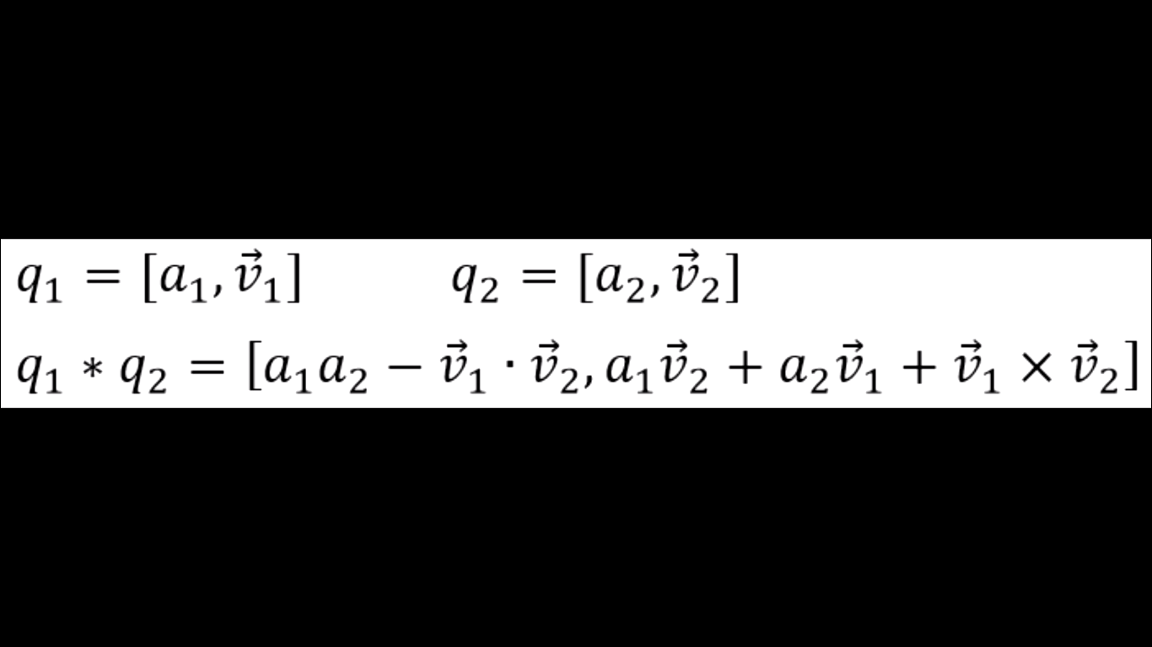
It is also possible to write the same form with this cute formula

Slide 24
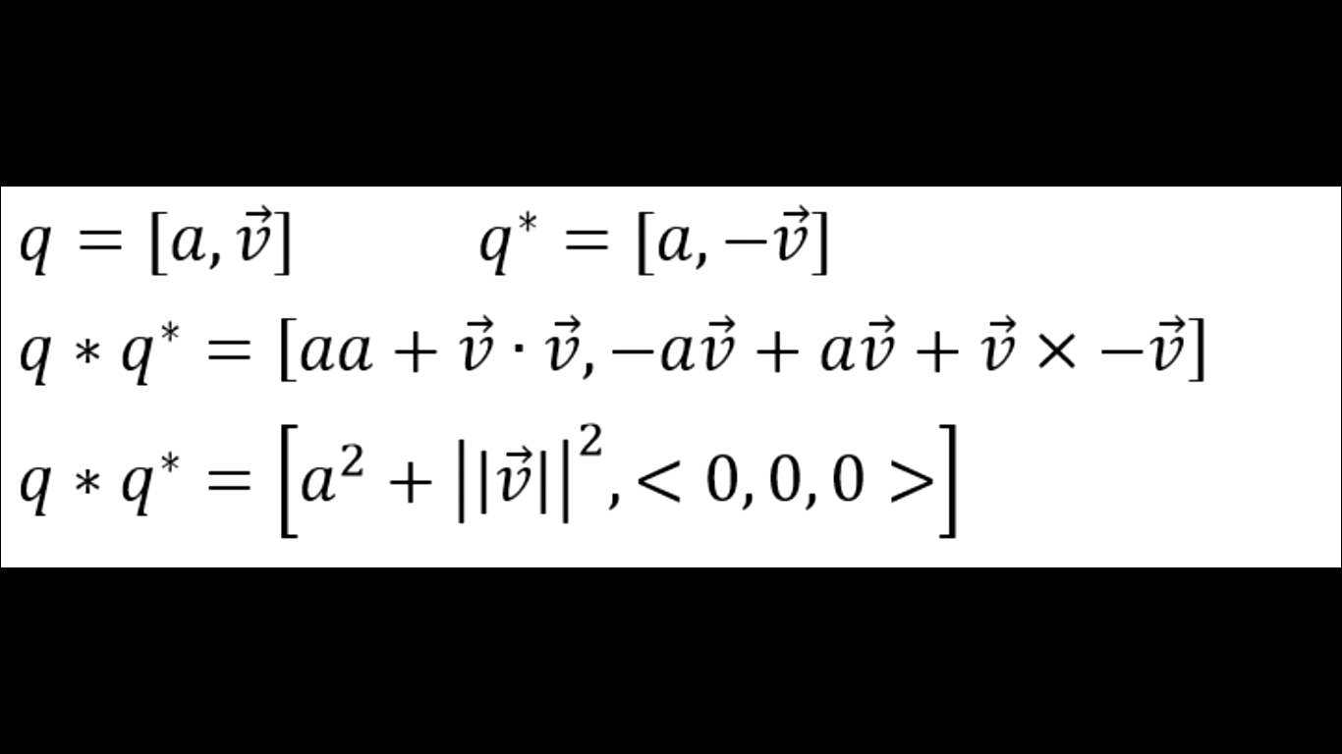
Conjugate of a quaternion q* looks like this and it follows the same properties of modulus and other math which a simple complex number follows

Slide 25
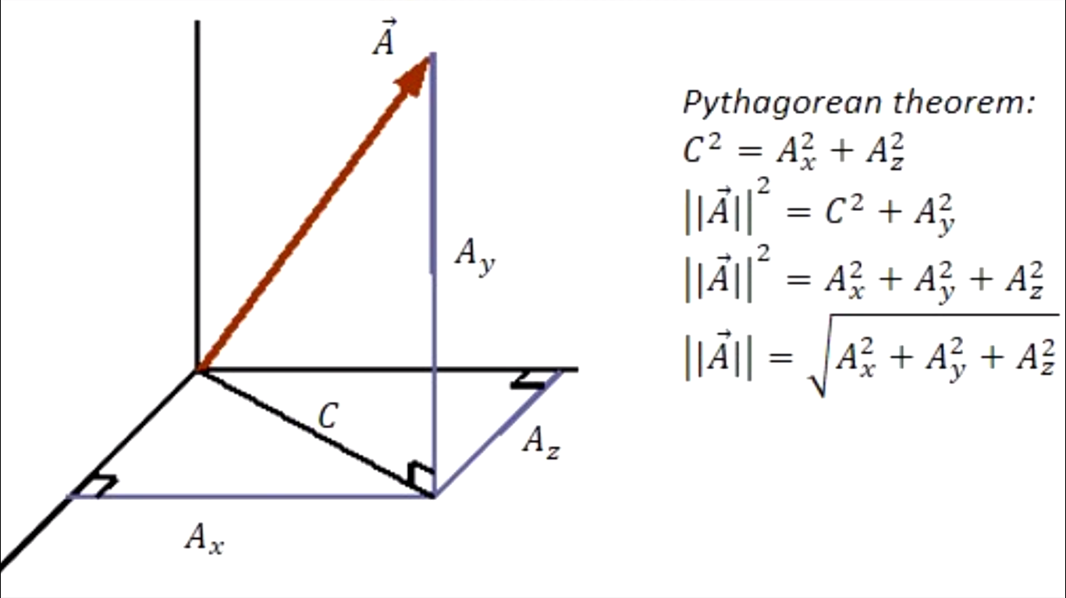
The modulus of a quaternion follows the pythagores theorem but in four diimensions

Slide 26
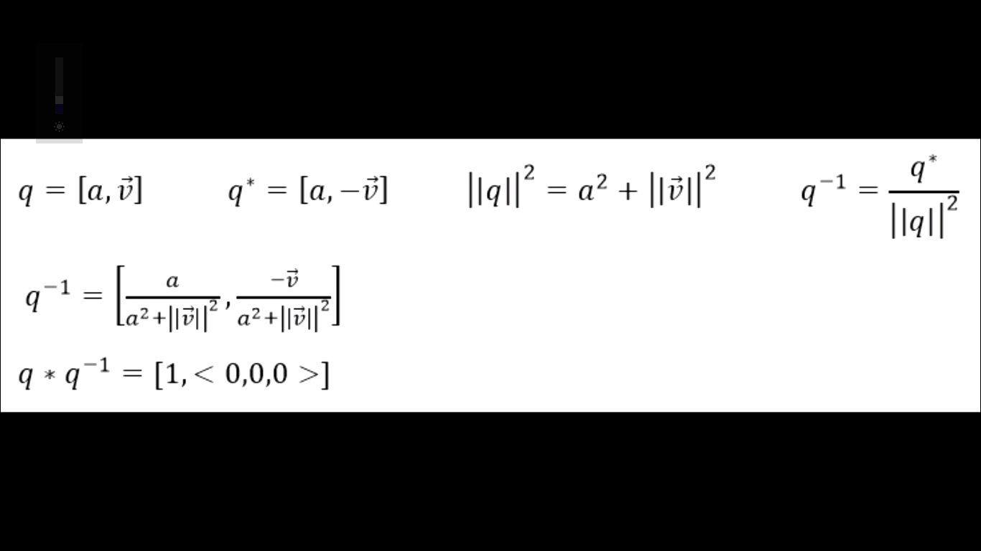
(Modulus)² = qq* and also see inverse property

Slide 27
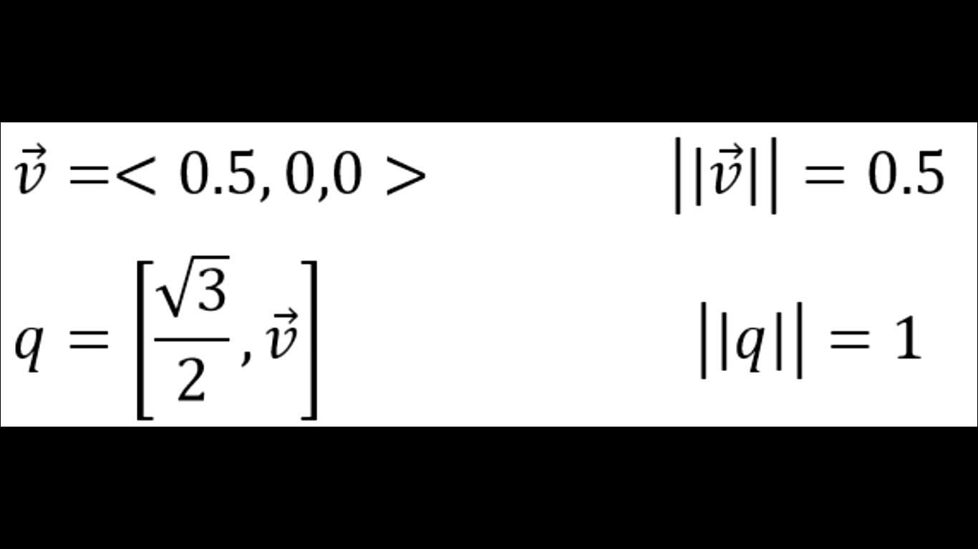
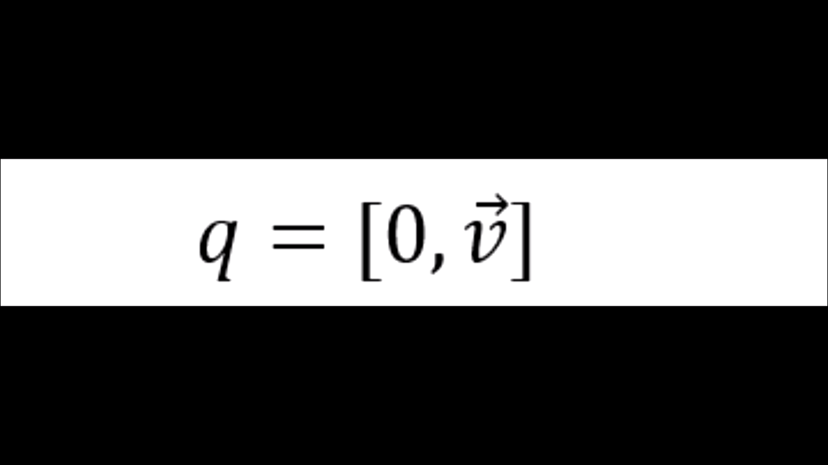
Unit quaternions and pure quaternions

Slide 28
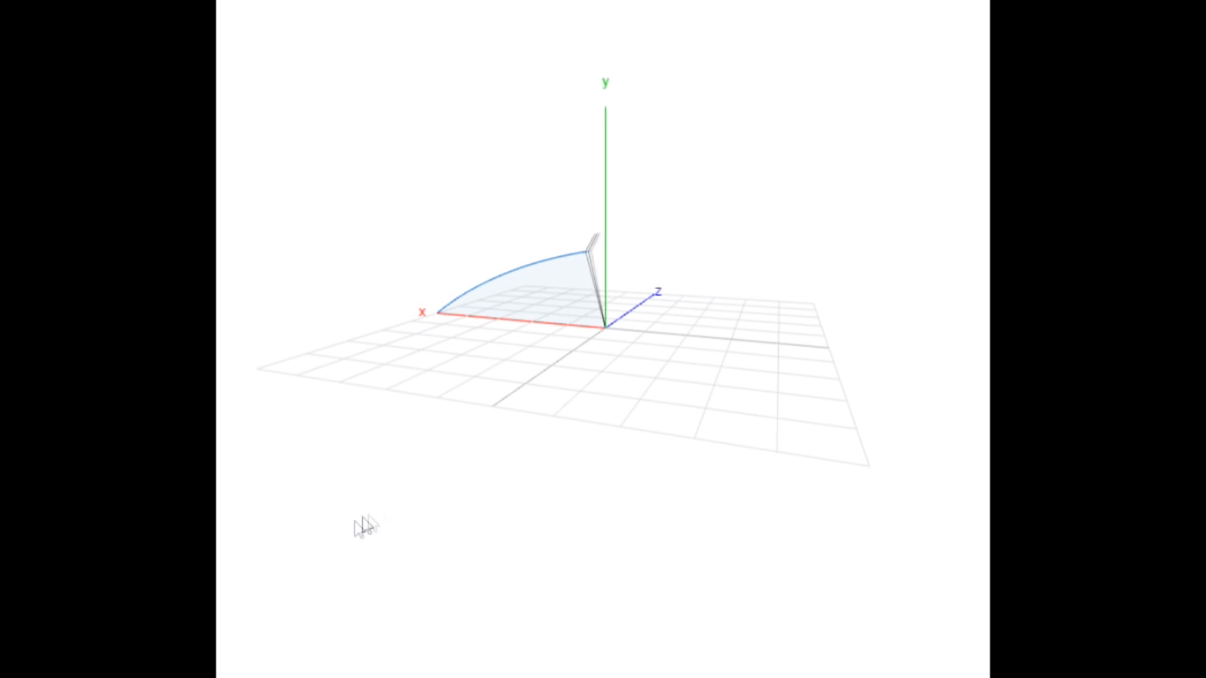
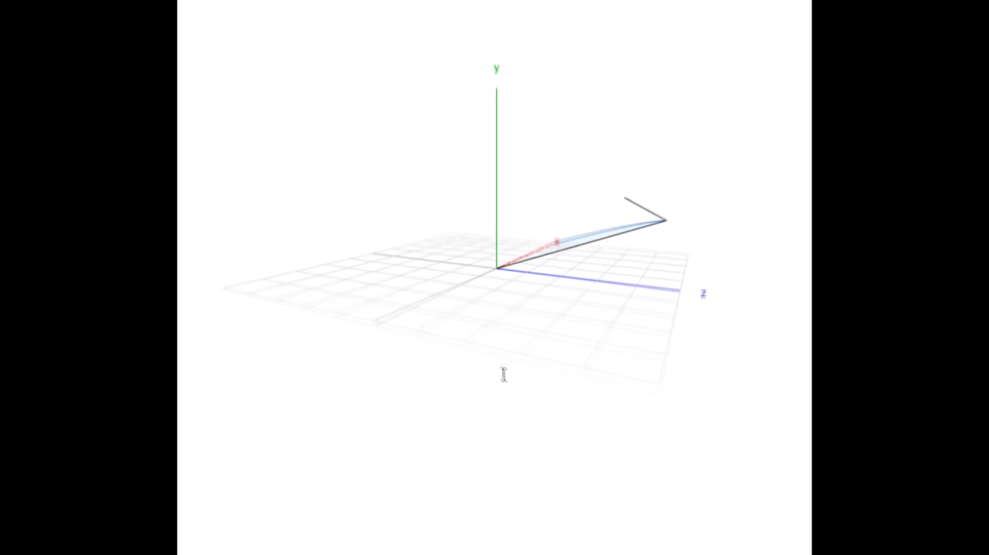
We use quaternions because they help us in rotations I form of simple multiplication

Slide 29
Advantage over other type of maths
Using this means we can avoid gimble lock like situations as was in euler rotations .

Slide 30
Rodrigues’ rotation
First let us understand this then later onrotation using quaternions

Slide 31
It let you to rotate a vector ( which is point basically in space ) about any unit vector n^ which you have defined.
Watch https://www.youtube.com/watch?v=OKr0YCj0BW4 for greater detail.

Slide 32
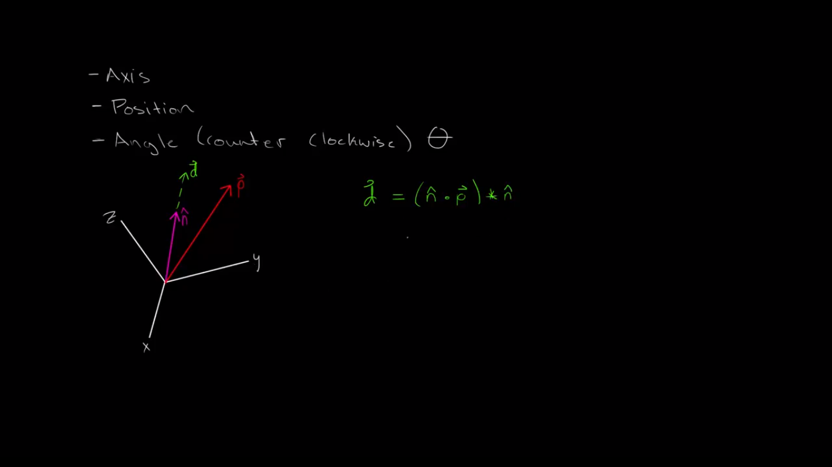
Let’s rotate p vector around n^ to other point

Slide 33
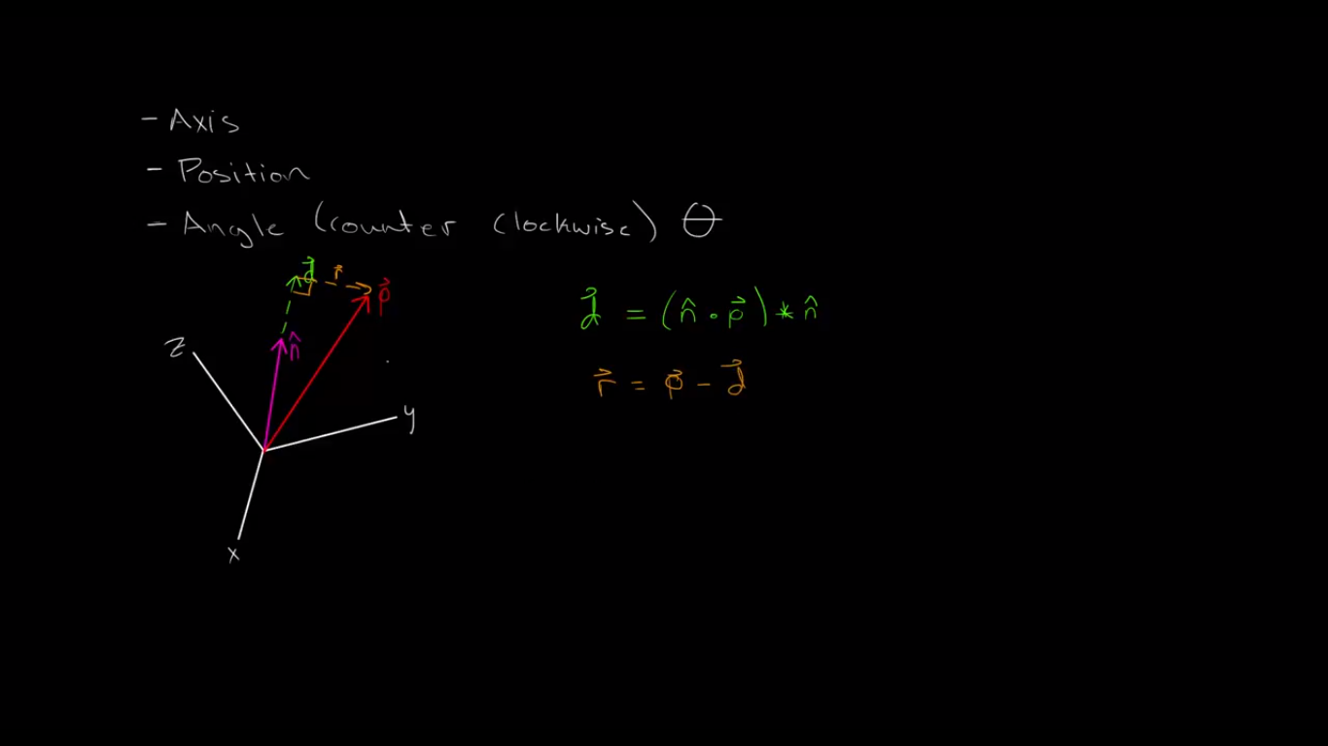
Now r vector is perpendicular to the n^ unit vector

Slide 34
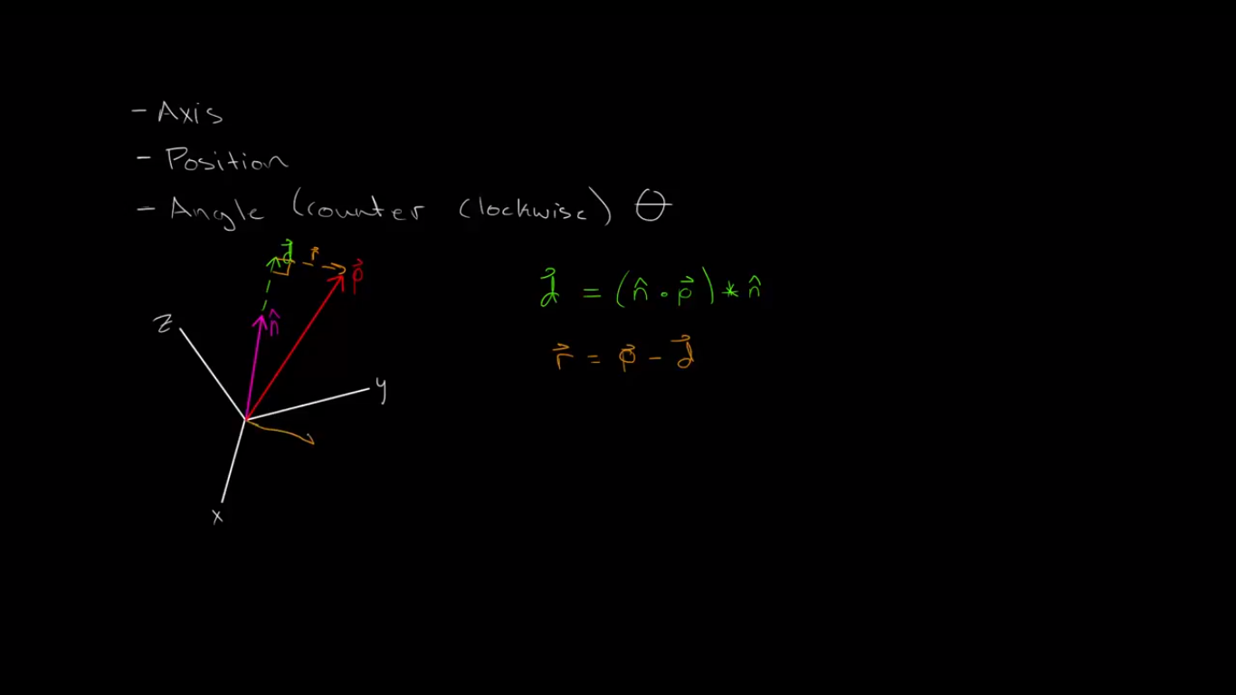
Projection of r vector to the origin.

Slide 35
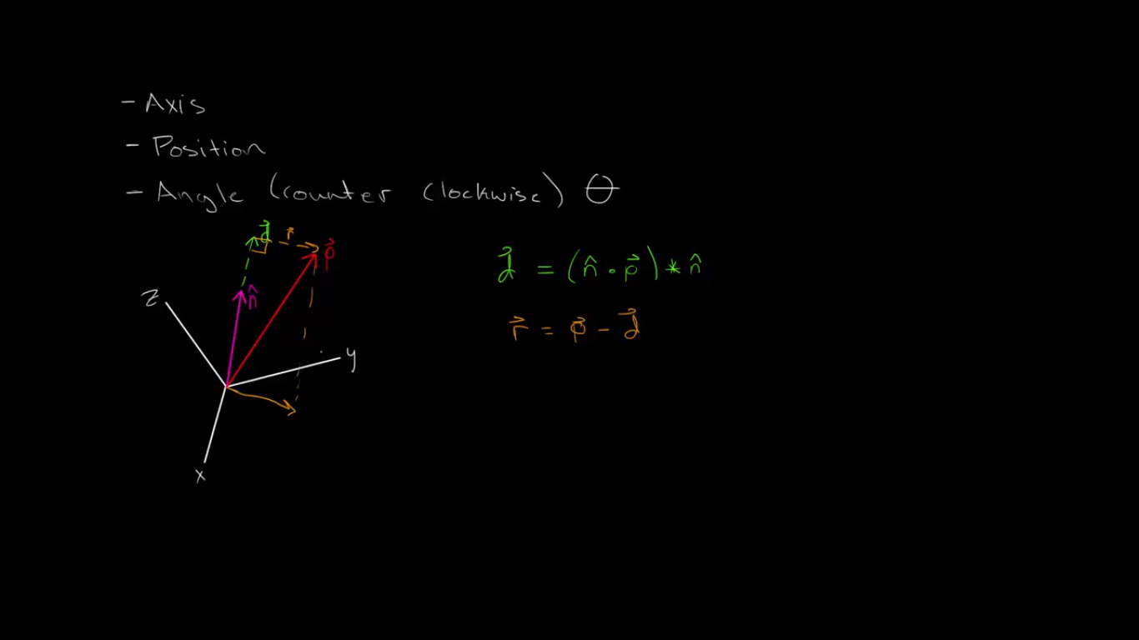

Slide 36

Now taking a perpendicular vector to the plane containing the n,p and r vector.

Slide 37
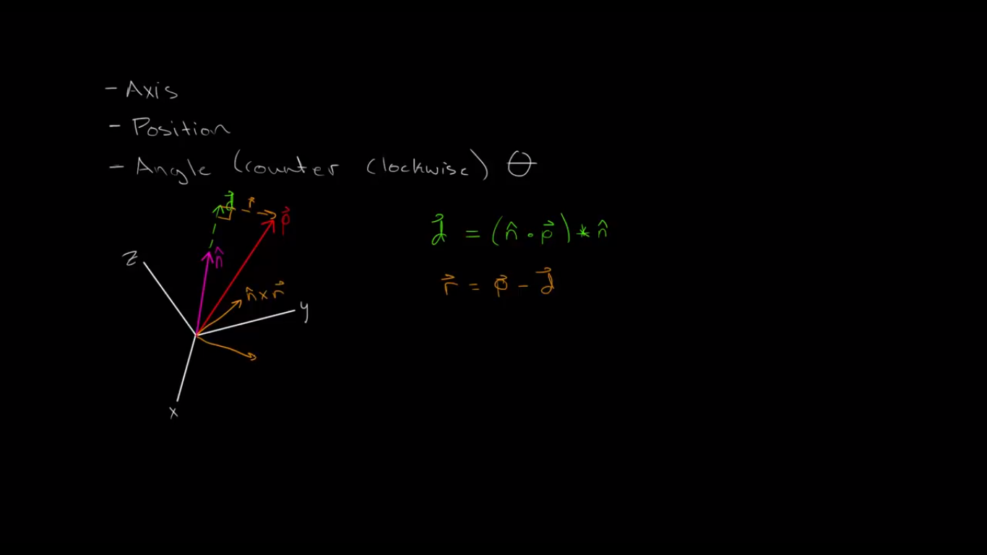

Slide 38
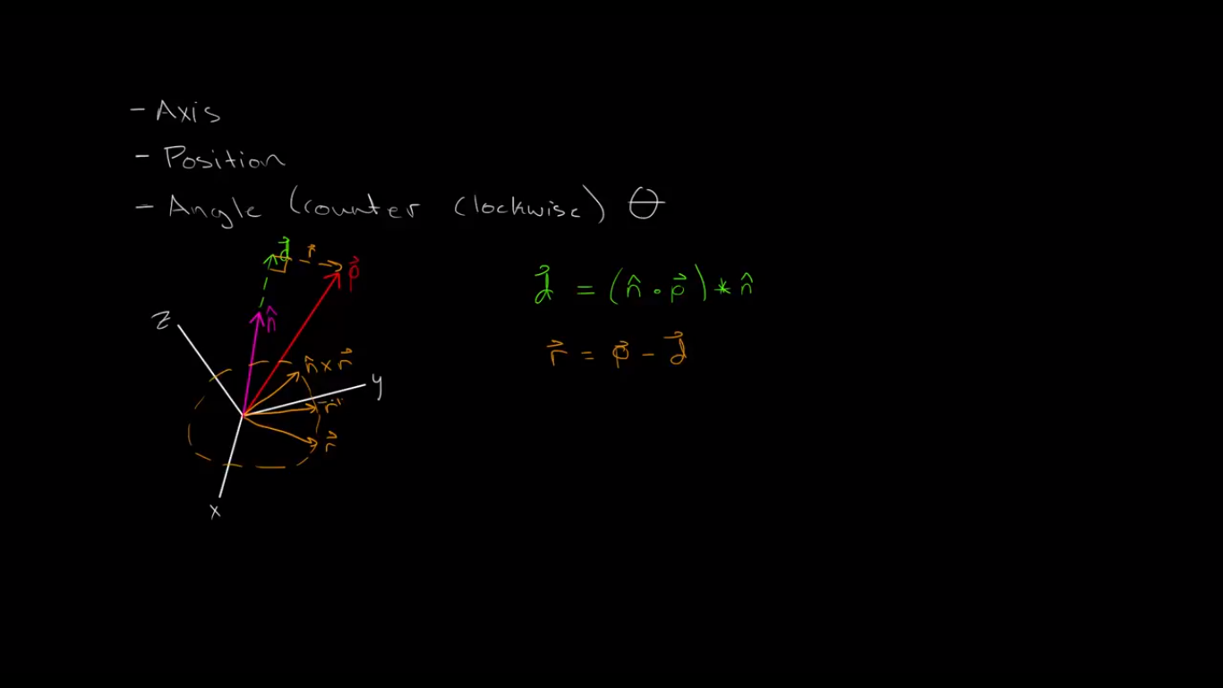
With the help of n*r vector and r vector we can point to any vector in the circular plane drawn

Slide 39
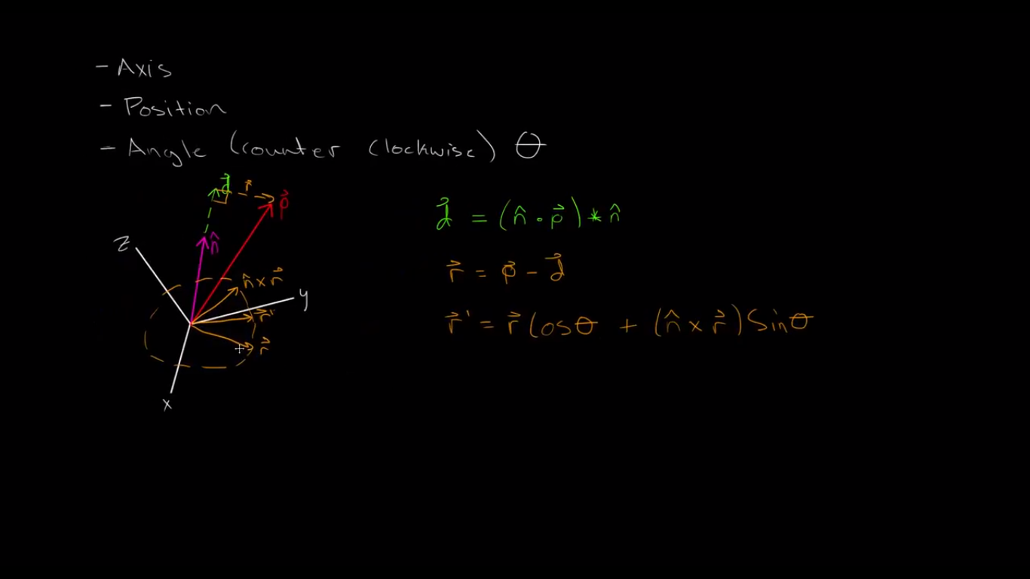
Let a vector be r’

Slide 40
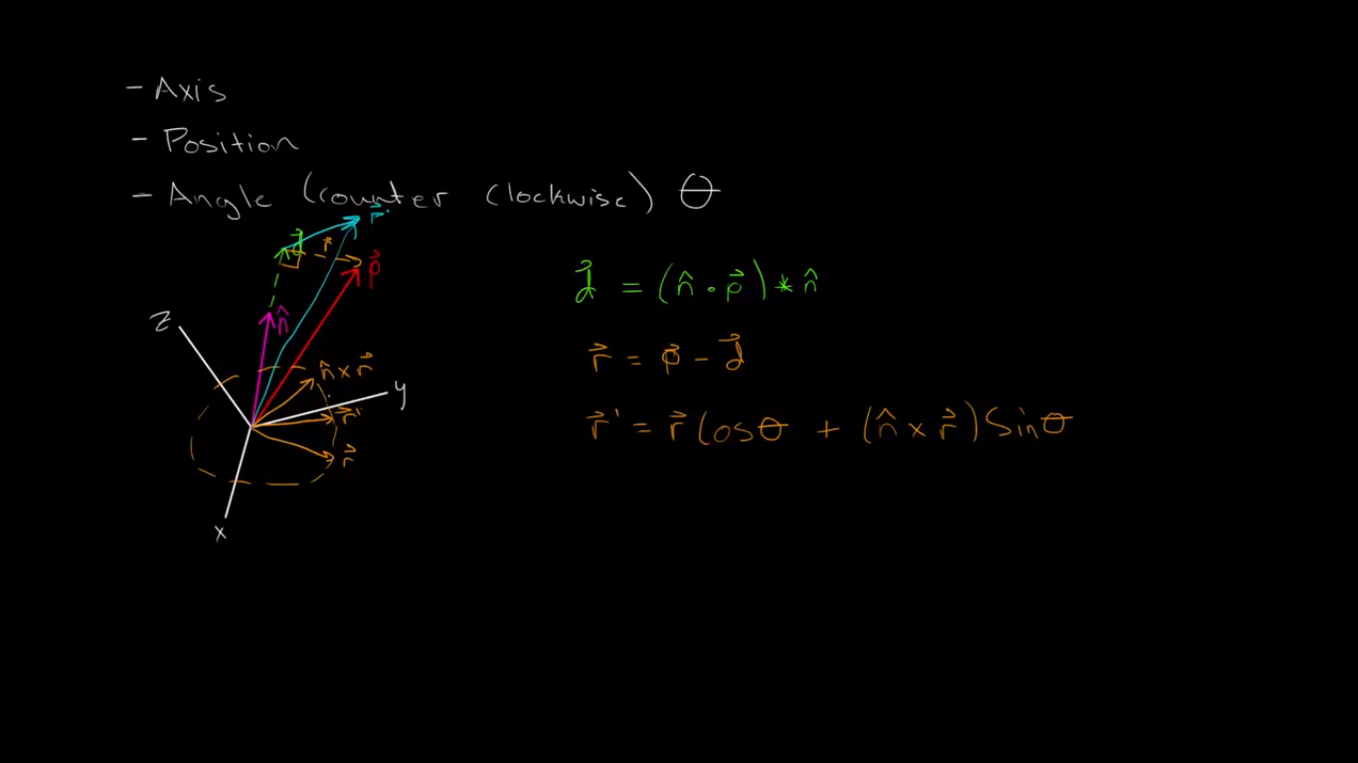
Now let’s take the r’ to the plane from where we actually borrowed the r vector

Slide 41
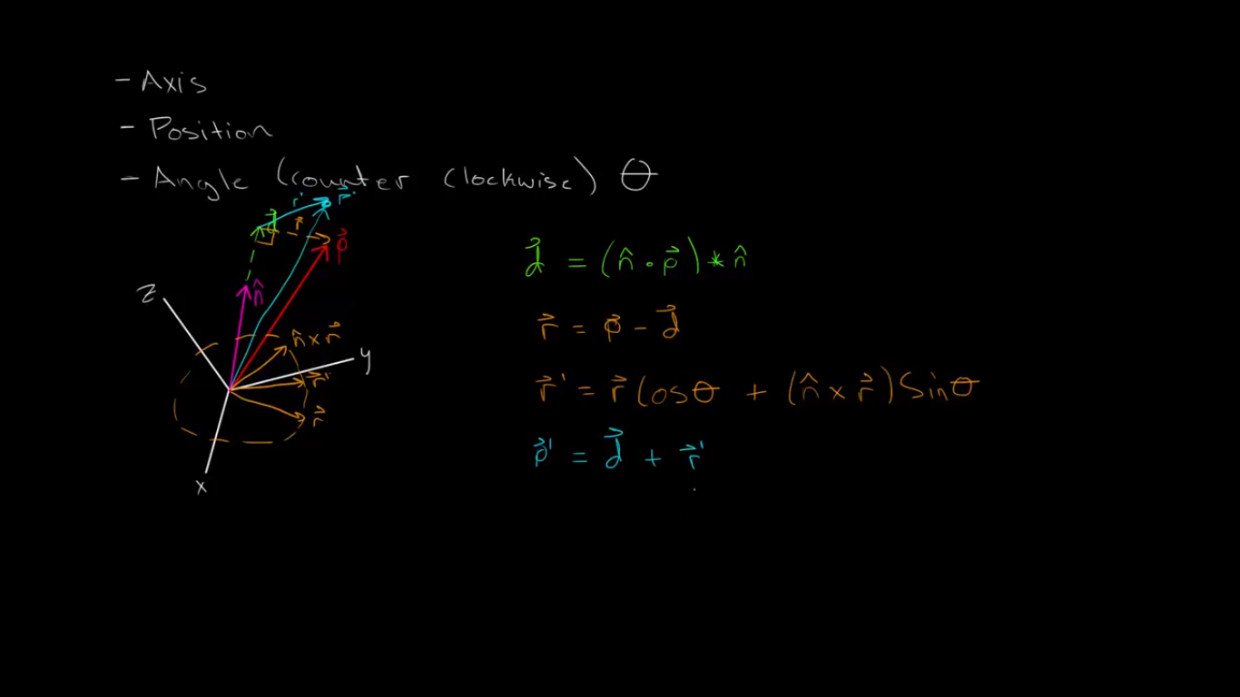
Now the point r’ in space is same like rotating the p around n vector . This is p’.

Slide 42
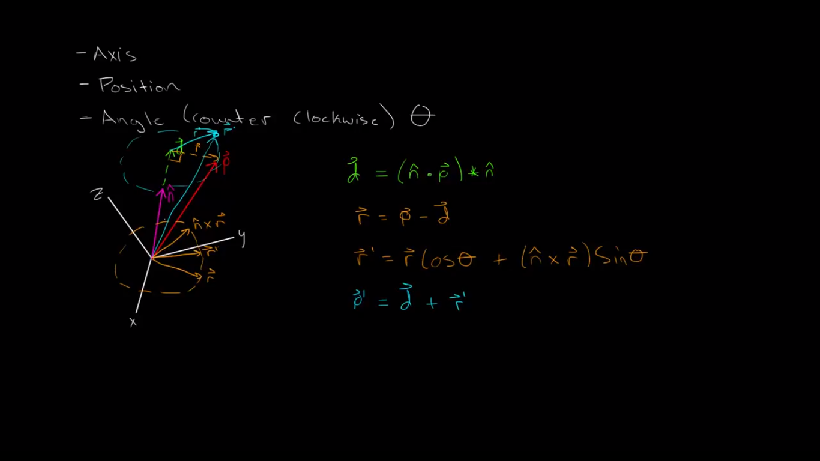

Slide 43
Now lets handle some real quaternions

Slide 44
Quaernions when rotated magnitude does not changes but the angels and other stuff do change.

Slide 45
Note q2 the vector to be rotated is pure Quaternions.
Like here we want to rotate q2 about q1 but the rotated vector we got a vector which is not pure quaternion . But it should be.
So we due to addition of fourth dimension we are getting troubled.

Slide 46
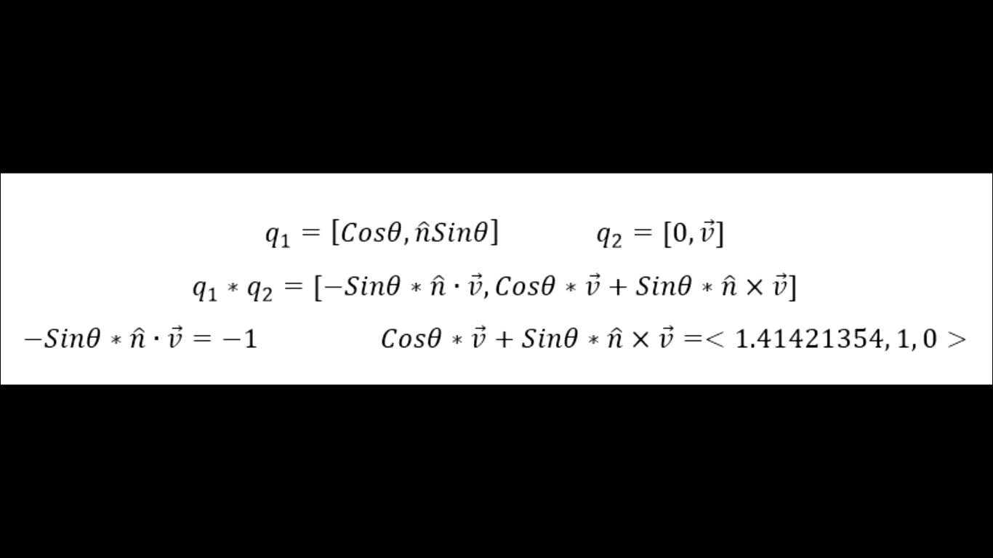

Slide 47
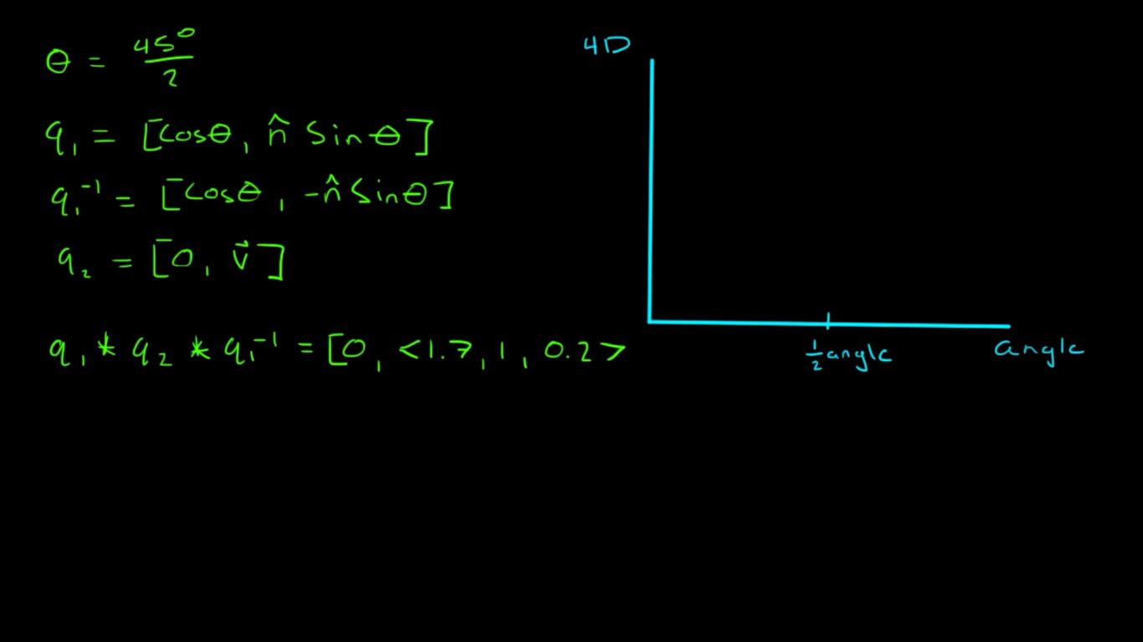
So to make corrections we multiply by q1*q2*q1⁻¹ .

Slide 48
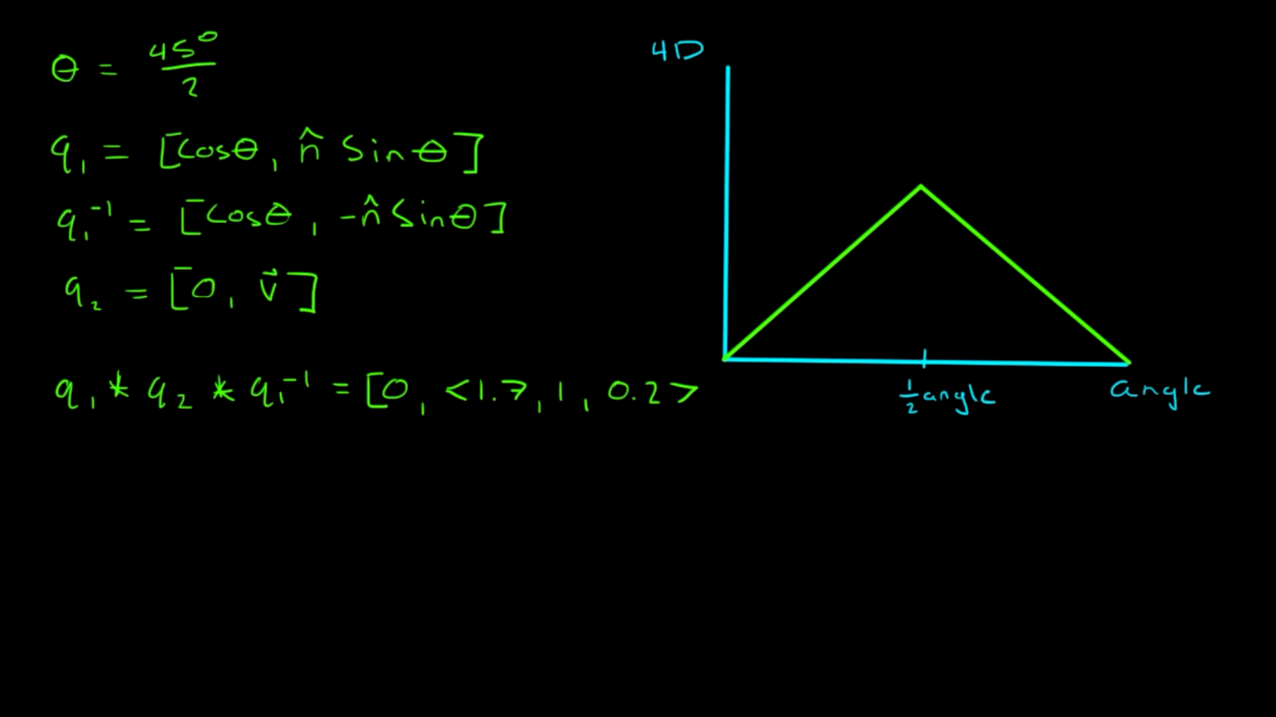
So what it actually does that q1 does half of rotation and q1⁻¹ does the other half.

Slide 49
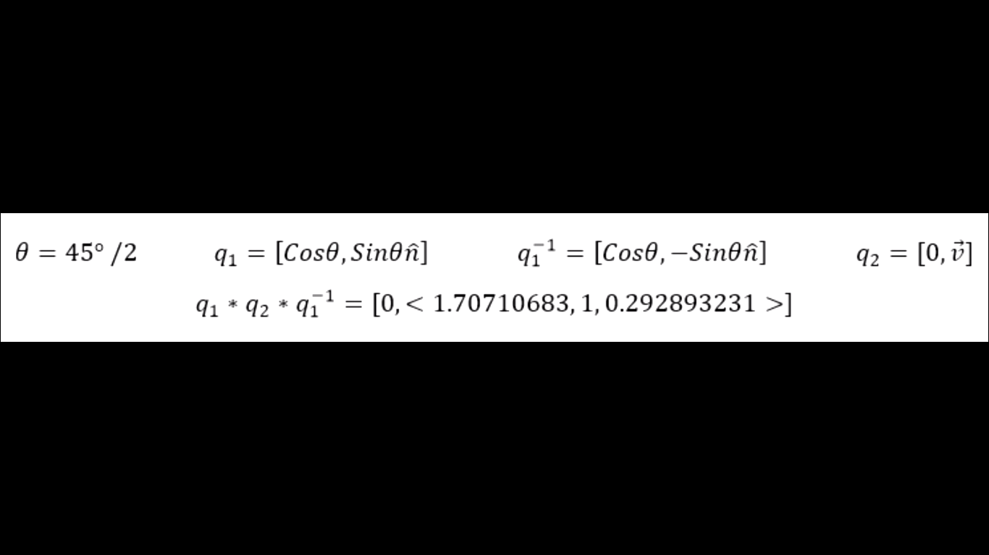
Cancelling all side effects.

